Slide 1
Usability and User Experience
Metropolia 2023
Amir Dirin

Slide 2

Why is important?
https://padlet.com/amir_dirin1/x40de2ccmiyacoae
Amir Dirin

Slide 3


What is Usability?
Learnability
Completeness
Efficiency
Speed, Effort
Memorability
Predictable
Errors tolerance
Prevention, recovery
Satisfaction
Engage the user, satisfying
Jakob Nielsen, “Usability Engineering, 1993”
[Usability refers to] the extent to which a product can be used by specific goals with effectiveness, efficiency and satisfaction in a specified context of use : ISO 9241-210
Notes:
33
Different definition but in general the ability of the user to use a product. The product to be usable and user achieve his/ her tasks easily without errors.
Usability has multiple components and is traditionally associated with five attributes:
Learnability, efficiency, memorability, errors and satisfaction.
This five E’ usability also depends where we apply is airplane the error tolerance is zero

Slide 4
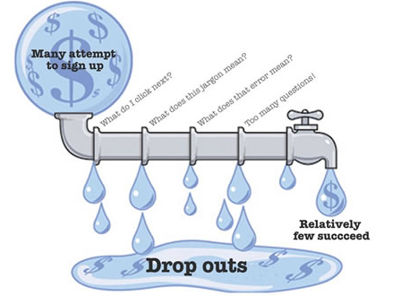
Poor Usability Result
Frustrated Users,
Visitor leaving
Reduction in Repeat visiting
Higher Support Cost
Decreased Productivity
Notes:
Usability applied to everything…not just online product…. As the user of the product how to use the product easily with safety…
Every day we encounter the usability problem. Some of which we may not notice and some result dramatic consequences… Lets see later on few examples.
The role of the usability engineering is to anticipate and correct these errors by applying various usability test methods on time…
We conduct diagnostic test whether thing working as they suppose to work
Comparative testing: We are not sure what options user like so we design and test
Verification: it meets the usability goals.
So by conducting the usability test we evaluate the product and not the user.

Slide 5
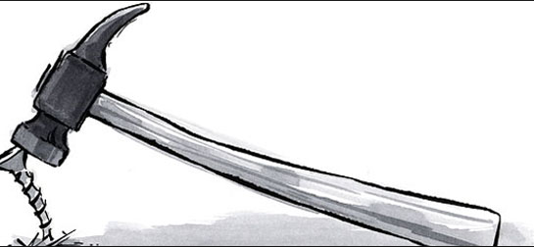

Why Isn’t Usability Done Regularly?
Top Management
Developers:
it takes too long
is too expensive
is not critical to development
may not know how to do it
…
Notes:
55

Slide 6
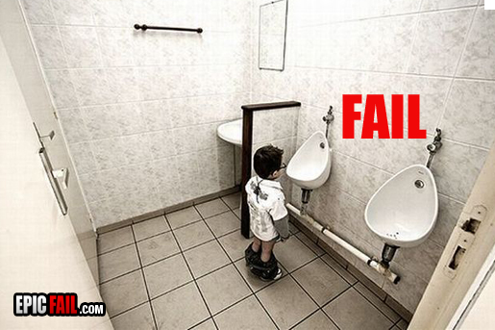
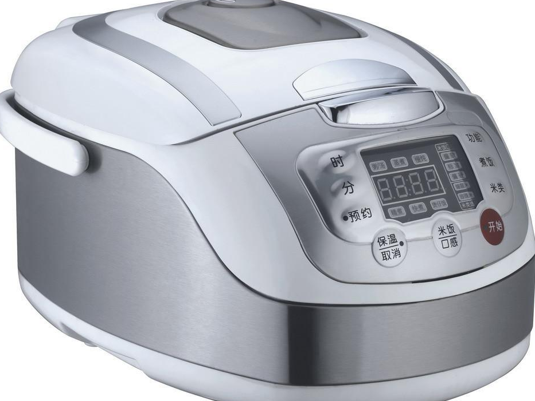
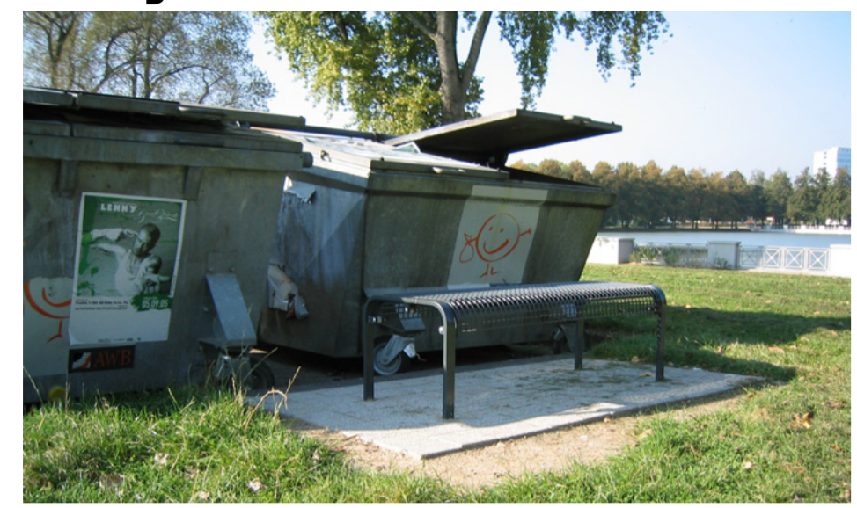
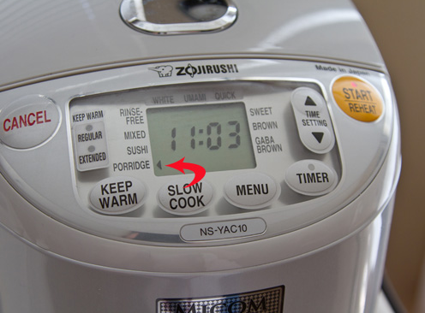
Developer vs. user
Relying solely on interior thinking is a risky approach to design
It risks making incorrect assumptions about the people who will use a system

Slide 7
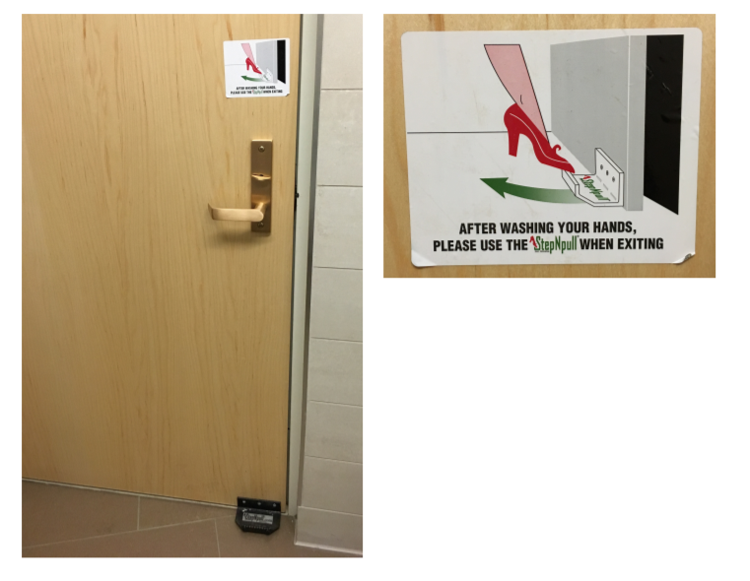
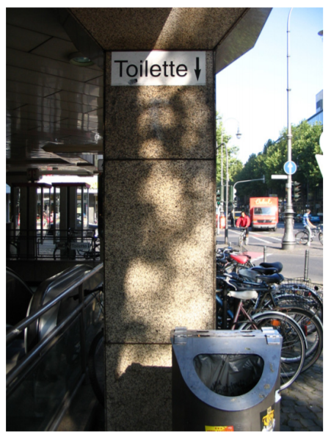
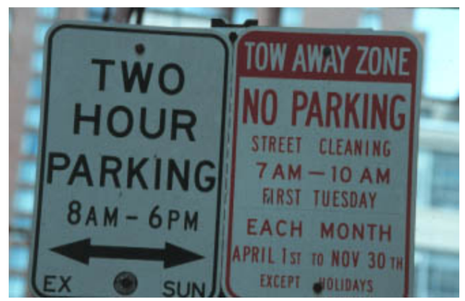

Slide 8
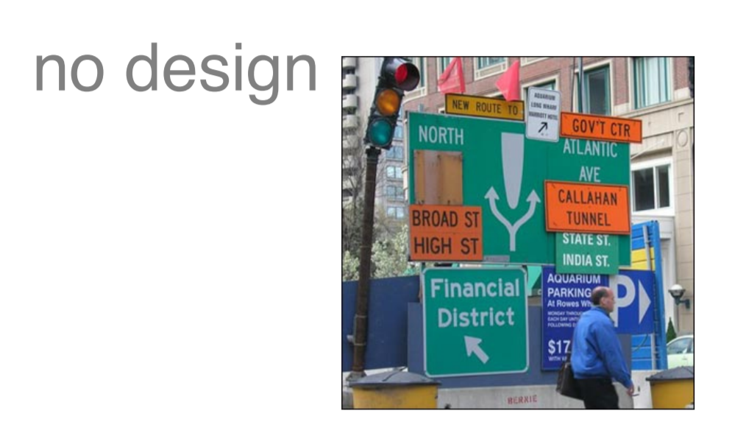
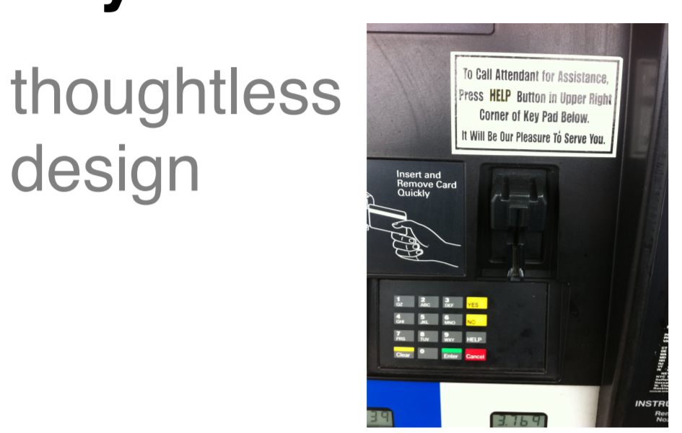

Slide 9
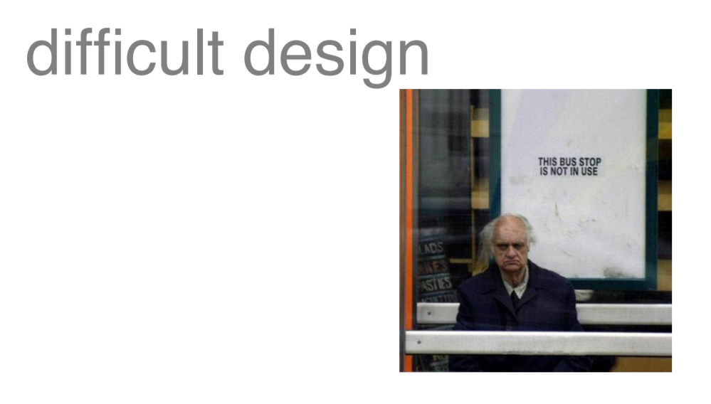
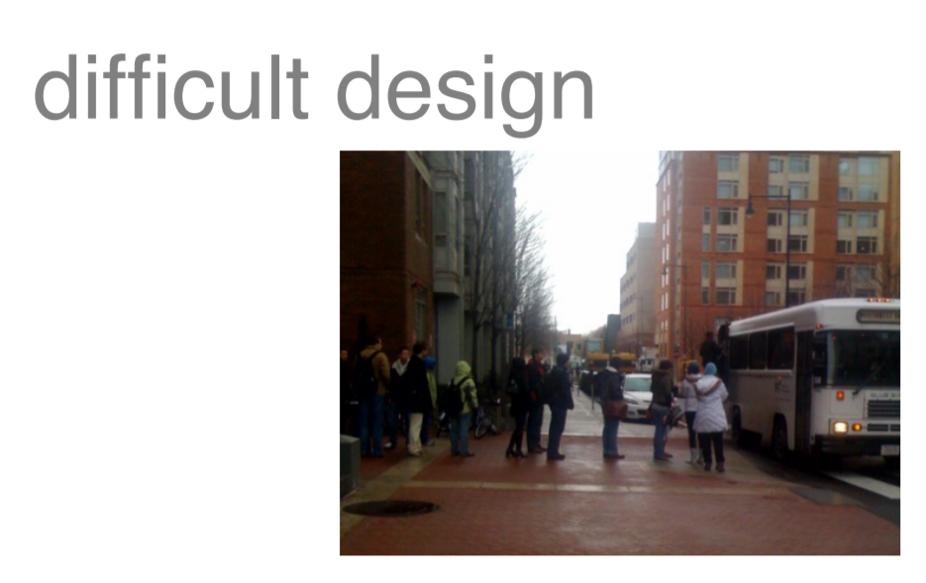

Slide 10
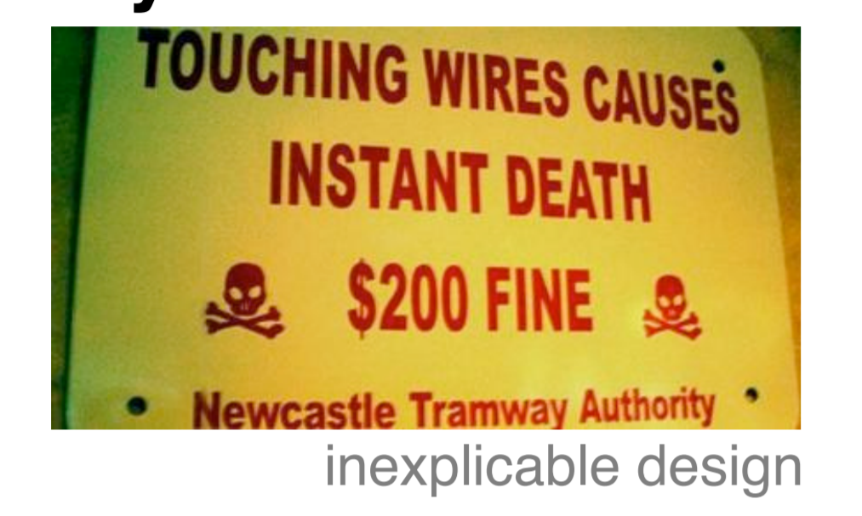

Slide 11

Types of Usability Problem
Product doesn’t match job or task
Poor organization / layout
Product not self-evident
Required recall rather than recognition
Inconsistent screens, Messages, terminology
Notes:
http://www.usefulusability.com/7-reasons-why-you-can%E2%80%99t-sell-usability/

Slide 12
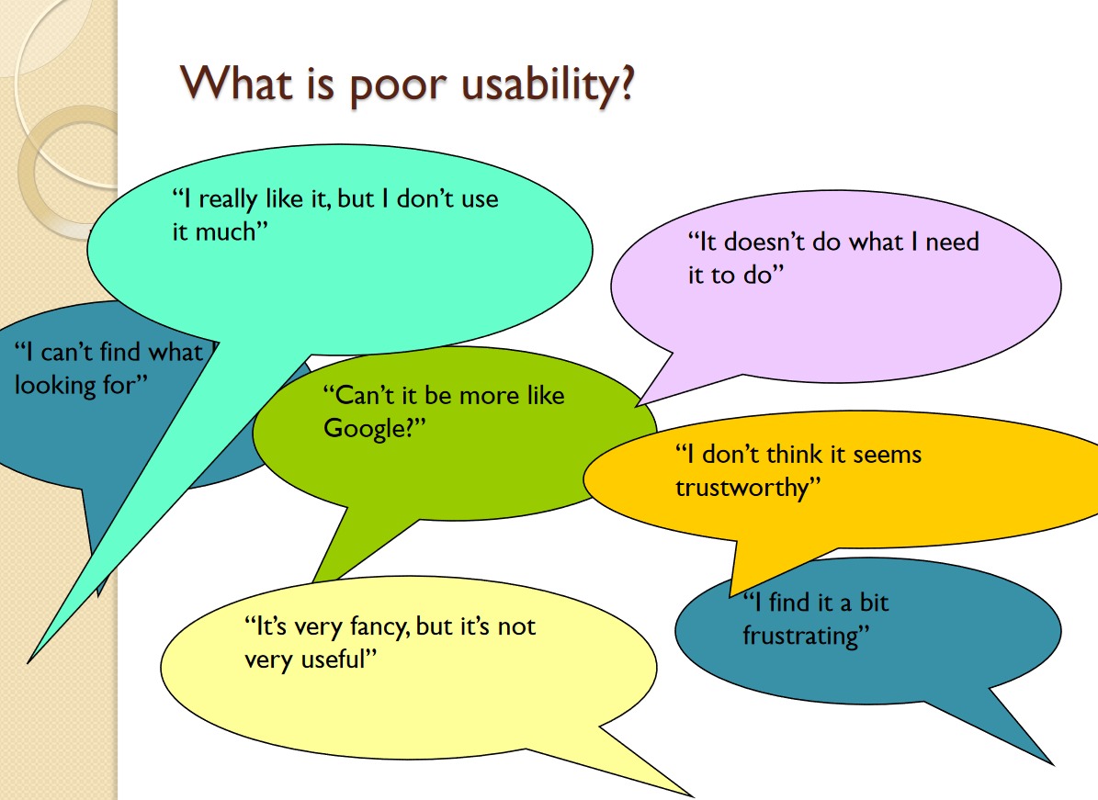

Slide 13
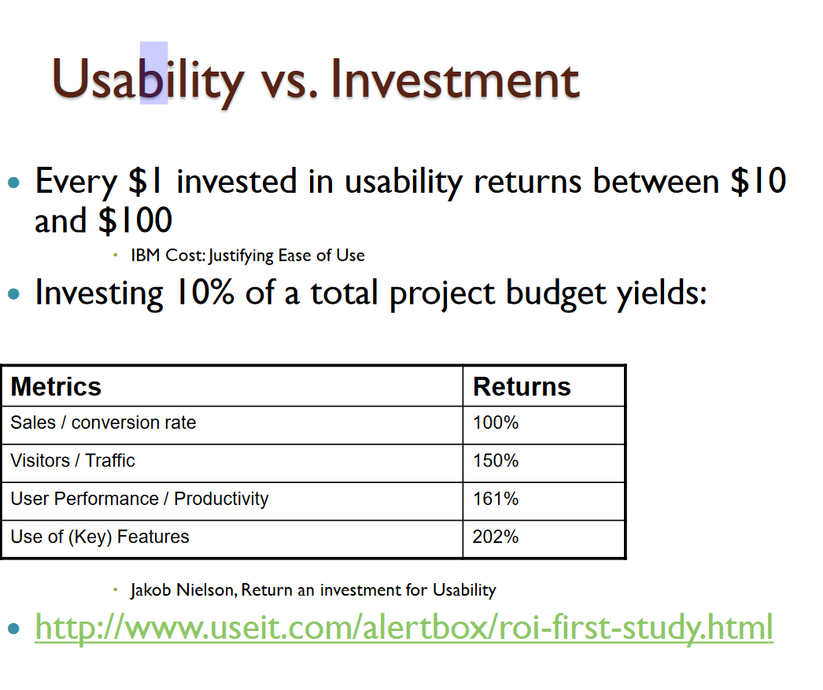

Slide 14
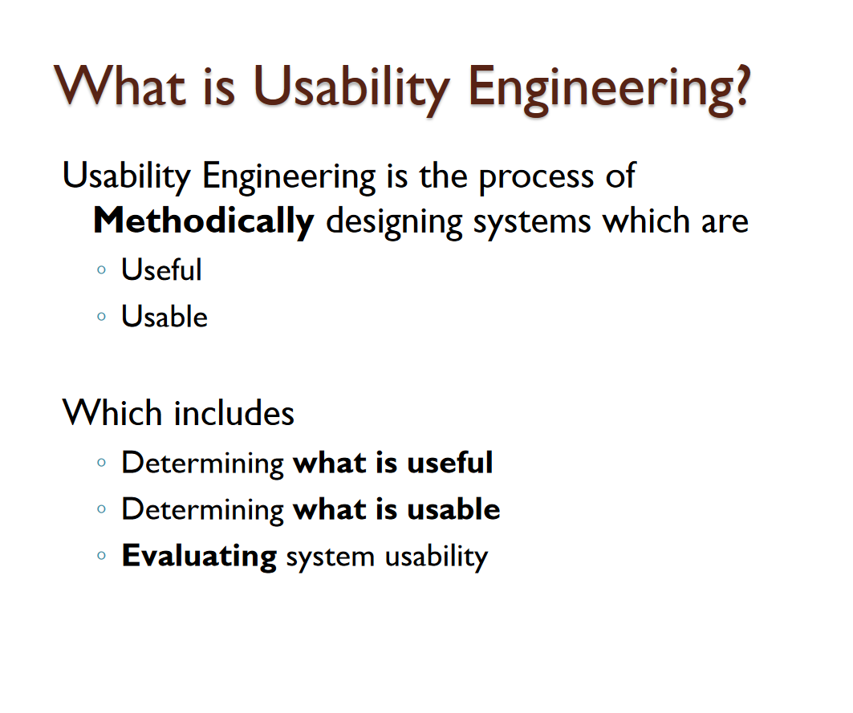

Slide 15
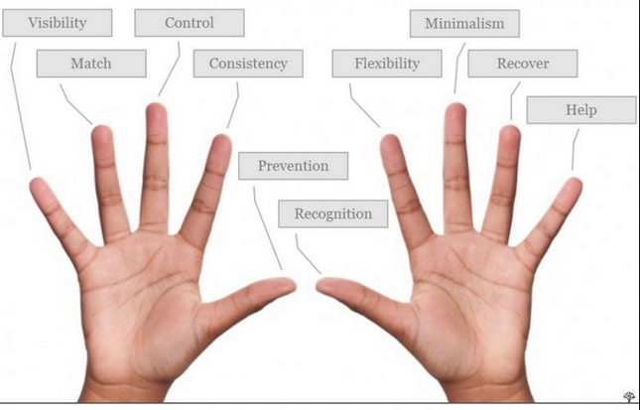
Benefits of Usability to the User
Notes:
1515
Usability became more and more important as the products get more and more complicate….
Less time to complete work
Greater success with tasks
Increased user satisfaction

Slide 16
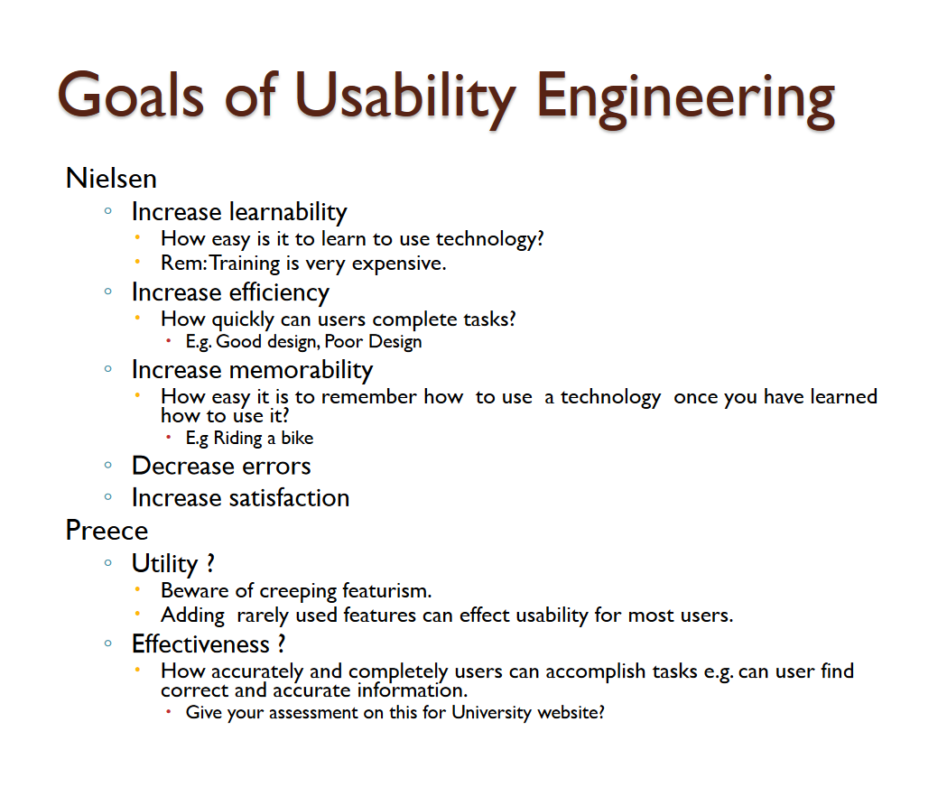

Slide 17

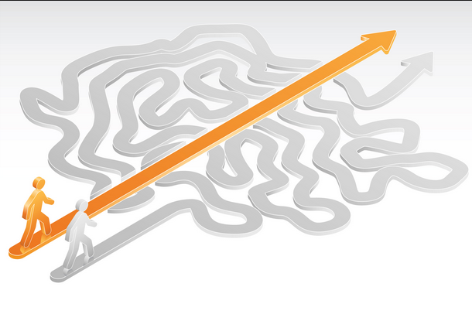
Return of investment
Every $1 invested in improving your websites returns $10 to $100 (Source IBM)
http://www.amanda.com/joomla_uploads/whitepapers/AM+A_ROIWhitePaper_20Apr0%201.pdf
A web usability redesign can increase the sales/conversion rate by 100% (source: Jakob Nielson Return an investment for Usability)
http://csi.ufs.ac.za/resres/files/Nielsen2.pdf
Notes:
http://stackoverflow.com/questions/395247/examples-of-usability-disasters

Slide 18
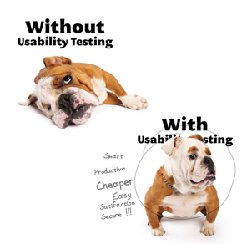

Benefits of Usability to an Organization
Reduce training costs
Reduce development costs
Identify and fix problems early
Reduce support costs; minimize need for
support personnel/help desks
fixes, maintenance, upgrades
…
Notes:
1818

Slide 19
EXAMPLES
Stop wasting your marketing budget on bad usability
http://www.youtube.com/watch?v=cwoSQypJ5to
Notes:
In Slide Show mode, click the arrow to enter the PowerPoint Getting Started Center.

Slide 20
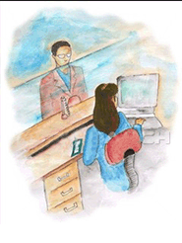

Stop wasting your marketing budget on bad usability

Slide 21
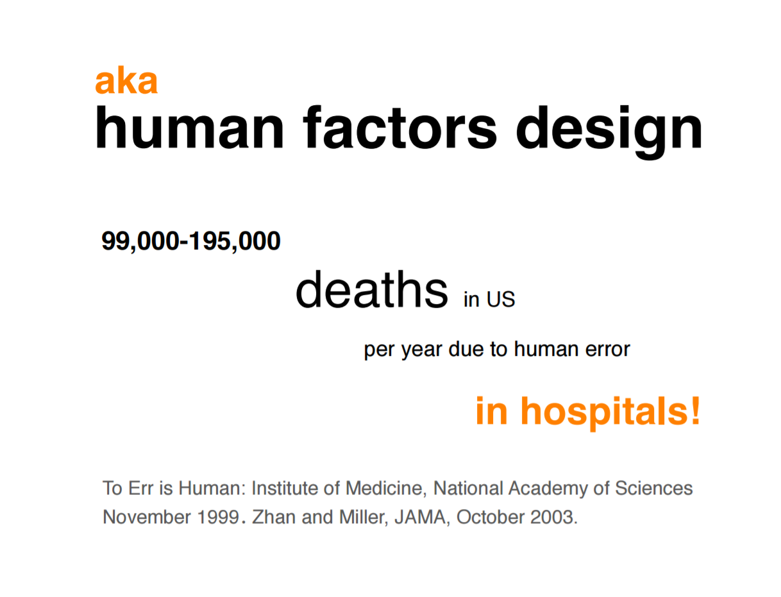

Slide 22
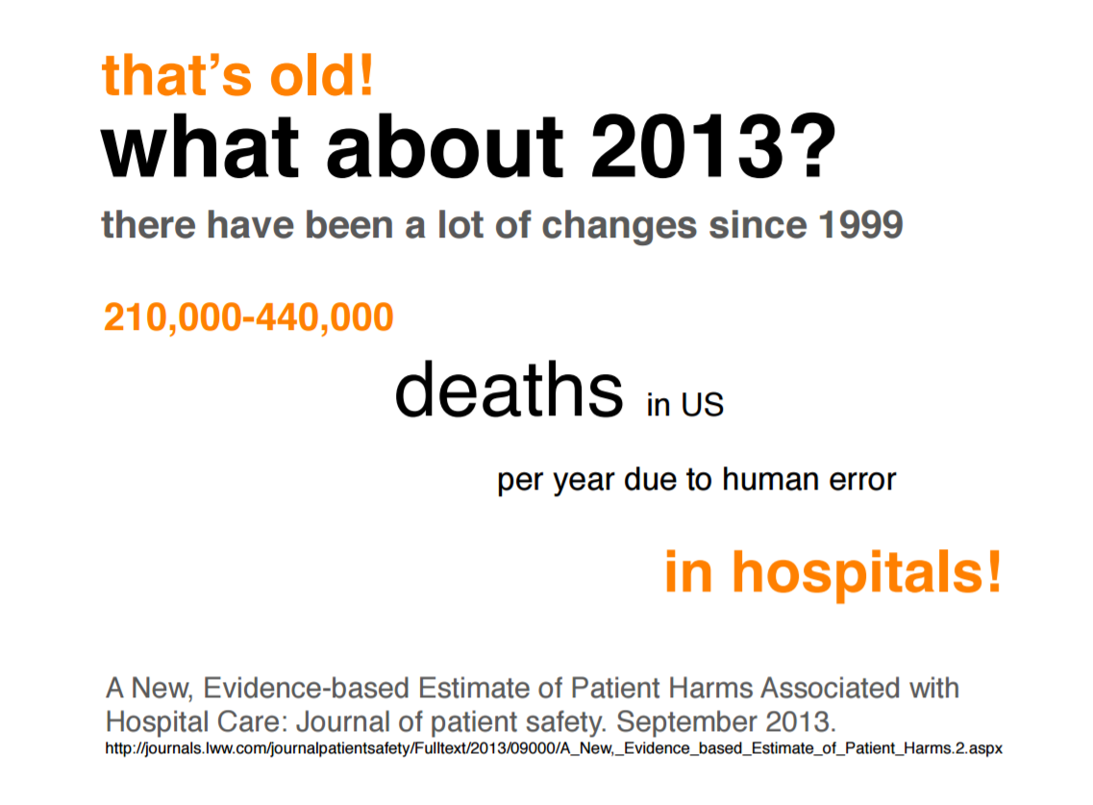

Slide 24
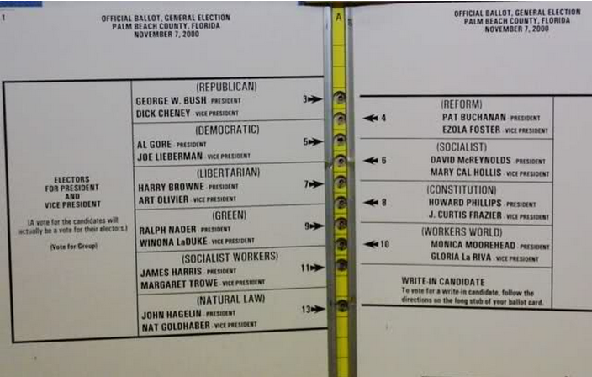
2000 Palm Beach election debacle
Notes:
Many voters associated the second block of candidates and the second hole in the ballot--erroneously voting for the Reform Party.

Slide 25
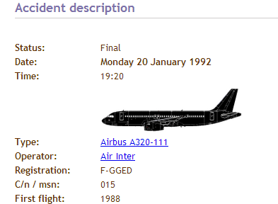
Mode switch in the wrong position
http://www.youtube.com/watch?v=I9gELPxPG8Q
Notes:
http://blog.powermapper.com/blog/post/Usability-Disasters.aspx
The Bureau d'Enquêtes et d'Analyses pour la Sécurité de l'Aviation Civile(BEA) believe that Flight 148 crashed because the pilots inadvertently left the autopilot set in Vertical Speed mode (instead of Flight Path Angle mode) then entered "33" for "3.3° descent angle", which for the autopilot meant a descent rate of 3,300 feet (1,000 m) per minute.^{[1]}
Airbus modified the interface of the autopilot so that a vertical speed setting would be displayed as a four-digit number, preventing confusion with Flight Path Angle mode.^{[3}
The cause of the crash was found to be a faulty design in an autopilot mode selector switch which led the flight crew to inadvertently select a 3,300 foot per minute descent rate on the approach instead of the desired 3.3° flight path angle.
Air France’s Airbus A320 crashed on January 20th, 1992. The same button was used for 2 different functions (speed and angle of descent). 87 people died.)

Slide 26
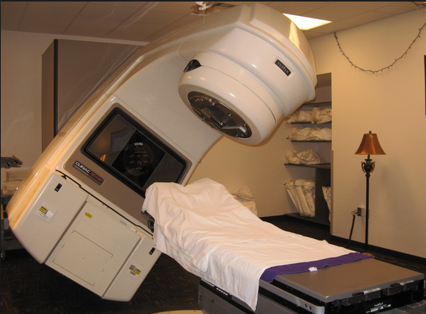
Therac-25 killed a number of patients due to unclear error messages
Notes:
Therac-25 was a medical linear accelerator, a device used to treat cancer. What made Therac-25 unique at the time of its use was the software. Not only did the software ease the laborious set-up process, but it also monitored the safety of the machine. In this case on safety critical software, you will find that some patients received much more radiation than prescribed despite the software safety programming,

Slide 27
https://www.youtube.com/watch?v=Ht12f8EJOys
Airplane crash

Slide 28
Quiz
List 3 actions that might lead to better user-centric design

Slide 29
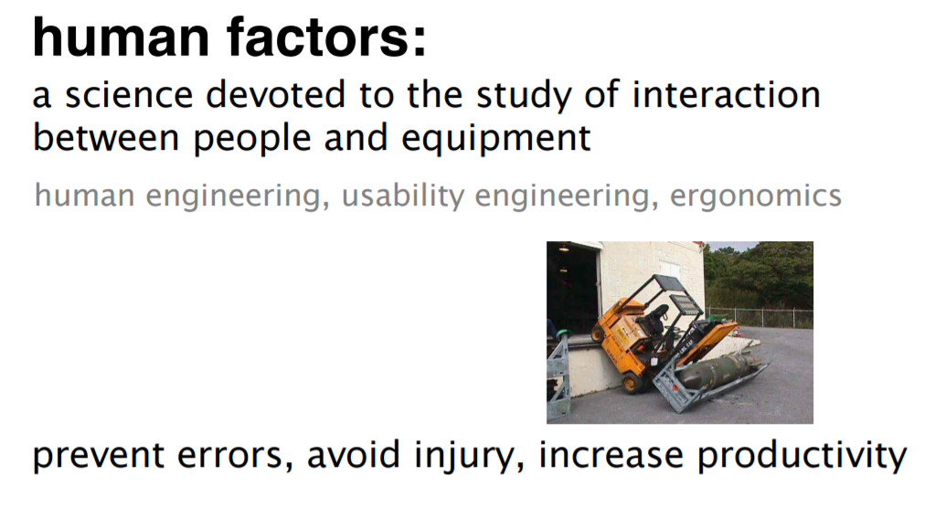

Slide 30

Thank You

